Slide 1
CSE215: Database Dr. Abu Sayed Md. Latiful Hoque Professor Dept. of CSE, BUET Contact: 01556346357 asmlatifulhoque@cse.buet.ac.bd

Slide 2
Course Methodology
Each lecture will have some questions to answer
You have to sit in the lecture with white paper and black ball point pen
You have to write the answer to the paper
Every Monday after class, you will have to upload the pdf of the answer of the questions.
These submissions will carry 50% marks of class attendance the remaining 50% will be taken from zoom attendance.
There will be 2 quizzes and 1 assignment

Slide 3
Content
Storage
Indexing
Query processing
Transaction
Concurrency Control
Recovery
Parallel and Distributed Database Overview

Slide 4
Classification of Physical Storage Media
Can differentiate storage into:
volatile storage: loses contents when power is switched off
non-volatile storage:
Contents persist even when power is switched off.
Includes secondary and tertiary storage, as well as batter-backed up main-memory.
Factors affecting choice of storage media include
Speed with which data can be accessed
Cost per unit of data
Reliability

Slide 5
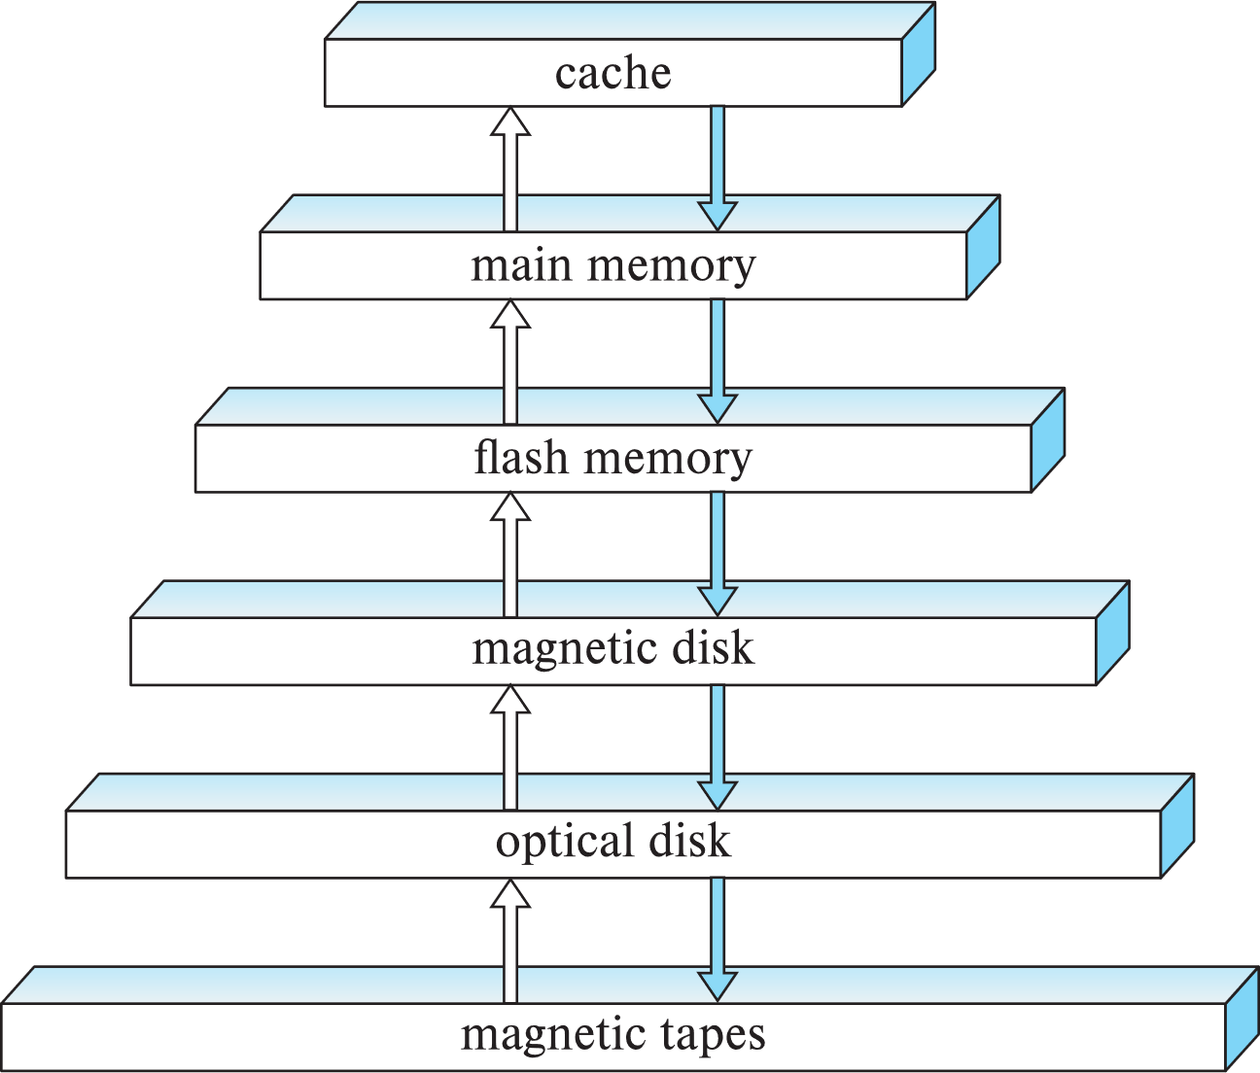
Storage Hierarchy
primary storage: Fastest media but volatile (cache, main memory).
secondary storage: next level in hierarchy, non-volatile, moderately fast access time
Also called on-line storage
E.g., flash memory, magnetic disks
tertiary storage: lowest level in hierarchy, non-volatile, slow access time
also called off-line storage and used for archival storage
e.g., magnetic tape, optical storage
Question 1-1: Which part of the memory is concerned with
(a) Disk-based DBMS (b) In Memory DBMS?

Slide 6
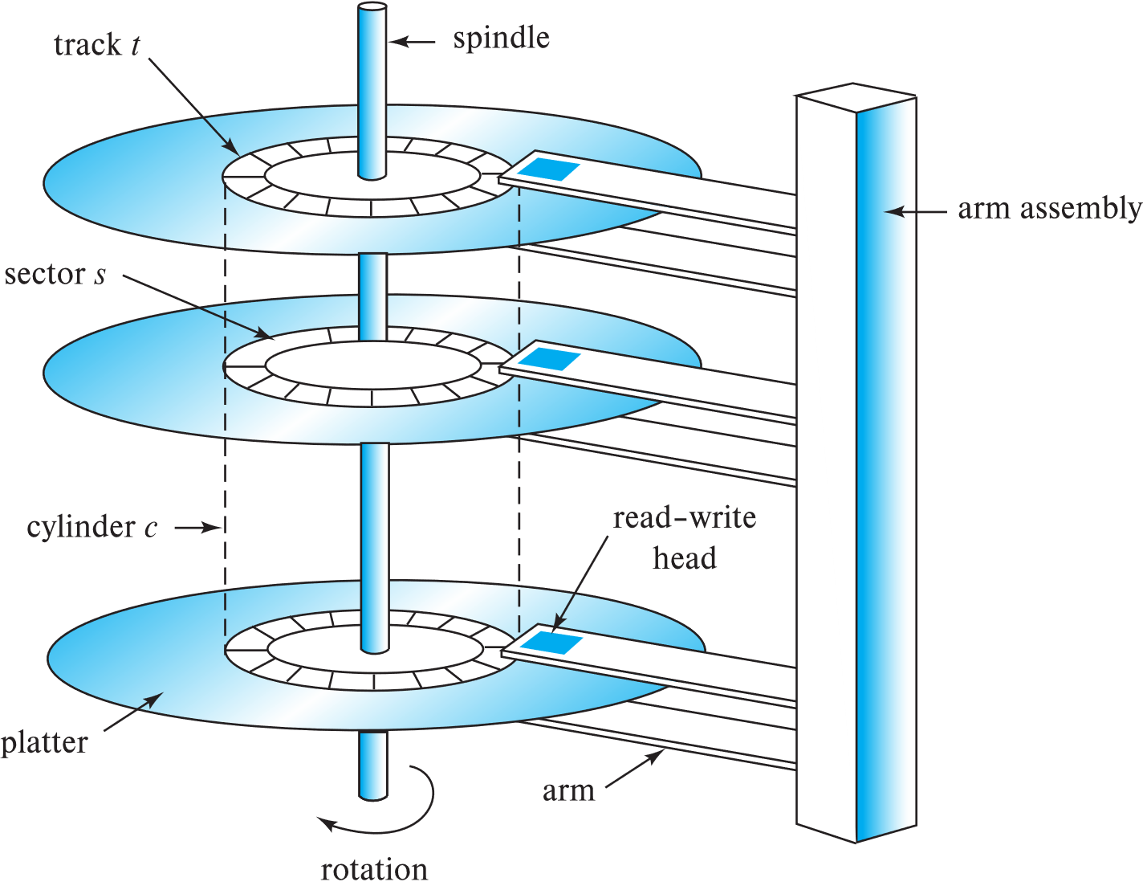
Magnetic Hard Disk Mechanism
Read-write head
Surface of platter divided into circular tracks
Over 50K-100K tracks per platter on typical hard disks
Each track is divided into sectors.
A sector is the smallest unit of data that can be read or written.
Sector size typically 512 bytes Typical sectors per track: 500 to 1000 (on inner tracks) to 1000 to 2000 (on outer tracks)
Schematic diagram of magnetic disk drive

Slide 7
Magnetic Hard Disk Mechanism
To read/write a sector:
disk arm swings to position head on right track;
platter spins continually;
data is read/written as sector passes under head
Head-disk assemblies multiple disk platters on a single spindle (1 to 5 usually).
one head per platter, mounted on a common arm.
Cylinder i consists of i^{th} track of all the platters
Schematic diagram of magnetic disk drive

Slide 8
Magnetic Hard Disk Mechanism
In a disk storage system, the outer most track number is 1 and inner most track number is 40000 for each platter. The number of sectors per track are given as follows:
Track number range | Number of sectors per track
1 - 20000 | 2000
20001 – 40000 | 1000
The size of the sector is 512 Byte. There are 2 sides in each platter and total of 5 platters in the disk.
Question 1-2
Find the storage size of one platter in GB with detailed calculations.
Find the storage size of the disk in GB with detailed calculations.
Schematic diagram of magnetic disk drive

